Slide 1
Why Deep Learning?
李宏毅
Hung-yi Lee
Notes:
22 pages

Slide 2

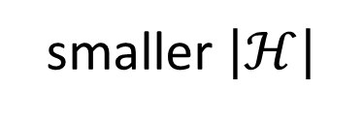




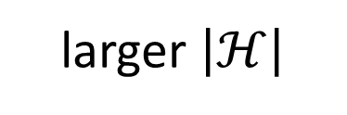
larger $\left|ℋ\right|$
smaller $\left|ℋ\right|$
$$L\left(h^{train},𝒟_{all}\right)$$
$$L\left(h^{train},𝒟_{all}\right)$$
small
large
large
$$L\left(h^{all},𝒟_{all}\right)$$
small
$$L\left(h^{all},𝒟_{all}\right)$$
魚與熊掌可以兼得嗎？
Still small loss
$$h^{all}=arg\min_{h∈ℋ}{L\left(h,𝒟_{all}\right)}$$
Small (fewer candidates)

Slide 3
Review: Why Hidden Layer?
Notes:
Should I mention “memory” network?
https://www.slideshare.net/pfi/deep-learning-practice-and-theory
P62
Two layer network is memory.

Slide 4

Piecewise Linear
https://youtu.be/bHcJCp2Fyxs
0
1
We can have good approximation with sufficient pieces.

Slide 5
piecewise
linear
= constant +
sum of a set of
0
1

Slide 6



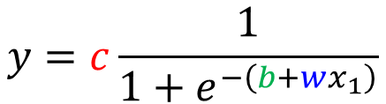
Piecewise linear
= constant +
sum of a set of
How to represent this function?
Hard Sigmoid
$$x_{1}$$
Sigmoid Function
$$y=c\frac{1}{1+e^{−\left(b+wx_{1}\right)}}$$
$$=c sigmoid\left(b+wx_{1}\right)$$
$$x_{1}$$
Notes:
Hard

Slide 7


















Piecewise linear
= constant +
sum of a set of
$$a_{1}$$
$$r_{1}$$
+
$$w_{11}$$
$$c_{1}$$
$$b_{1}$$
$$w_{12}$$
$$x_{1}$$
1
$$w_{13}$$
$$c_{2}$$
$$x_{2}$$
$$y$$
+
$$a_{2}$$
$$r_{2}$$
+
$$b$$
1
$$x_{3}$$
1
$$c_{3}$$
$$a_{3}$$
$$r_{3}$$
+
1

Slide 8





Hard Sigmoid $→$ ReLU
How to represent this function?
$$x_{1}$$
Rectified Linear Unit (ReLU)
$$c max\left(0,b+wx_{1}\right)$$
$$x_{1}$$
$$c′ max\left(0,b′+w′x_{1}\right)$$

Slide 9















Piecewise linear
= constant +
sum of a set of
+
=
$$a_{1}$$
$$r_{1}$$
+
$$w_{11}$$
$$c_{1}$$
$$b_{1}$$
$$w_{12}$$
$$x_{1}$$
1
$$w_{13}$$
$$c_{2}$$
$$x_{2}$$
$$y$$
+
$$a_{2}$$
$$r_{2}$$
+
$$b$$
1
$$x_{3}$$
1
$$c_{3}$$
$$a_{3}$$
$$r_{3}$$
+
……
1
Why we want “Deep” network, not “Fat” network?

Slide 10
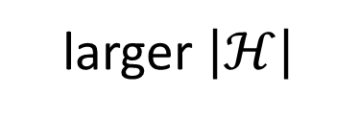


Deeper is Better?
Layer X Size | Word Error Rate (%) | Layer X Size | Word Error Rate (%)
1 X 2k | 24.2
2 X 2k | 20.4
3 X 2k | 18.4
4 X 2k | 17.8
5 X 2k | 17.2 | 1 X 3772 | 22.5
7 X 2k | 17.1 | 1 X 4634 | 22.6
 |  | 1 X 16k | 22.1
larger $\left|ℋ\right|$
$$L\left(h^{train},𝒟_{all}\right)$$
large
small
$$L\left(h^{all},𝒟_{all}\right)$$
Seide Frank, Gang Li, and Dong Yu. "Conversational Speech Transcription Using Context-Dependent Deep Neural Networks." Interspeech. 2011.
Notes:
SWB
For a fixed number of parameters, a deep model is clearly better than the shallow one.

Slide 11
Fat + Short v.s. Thin + Tall
The same number of parameters
Which one is better?
……
……
……
Shallow
Deep

Slide 12
Fat + Short v.s. Thin + Tall
Layer X Size | Word Error Rate (%) | Layer X Size | Word Error Rate (%)
1 X 2k | 24.2
2 X 2k | 20.4
3 X 2k | 18.4
4 X 2k | 17.8
5 X 2k | 17.2 | 1 X 3772 | 22.5
7 X 2k | 17.1 | 1 X 4634 | 22.6
 |  | 1 X 16k | 22.1
Why?
Seide Frank, Gang Li, and Dong Yu. "Conversational Speech Transcription Using Context-Dependent Deep Neural Networks." Interspeech. 2011.

Slide 13
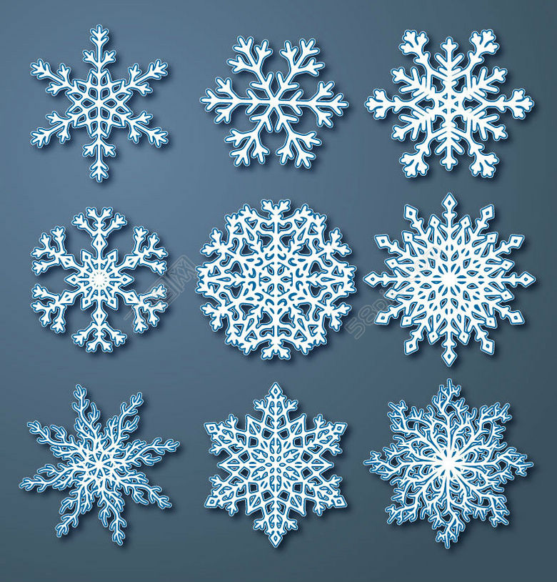
Why we need deep?

Slide 14
Why we need deep?
Yes, one hidden layer can represent any function.
However, using deep structure is more effective.
Shallow
More parameters
Deep
>

Slide 15
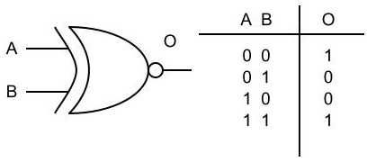
Analogy – Logic Circuits
E.g., parity check
1 0 1 0
Circuit
For input sequence with d bits,
1 (even)
Circuit
Two-layer circuit need O(2^{d}) gates.
0 0 0 1
0 (odd)
XNOR
1
0
0
1
0
1
0
With multiple layers, we need only O(d) gates.
Notes:
Any Boolean function can be written as a sum of products (disjunctive normal form: AND gates on the first layer with optional negation of inputs, and OR gate on the second layer) or a product of sums (conjunctive normal form: OR gates on the first layer with optional negation of inputs, and AND gate on the second layer).
同位元檢查(Parity Check)
00 1
01 0
10 0
11 1

Slide 16
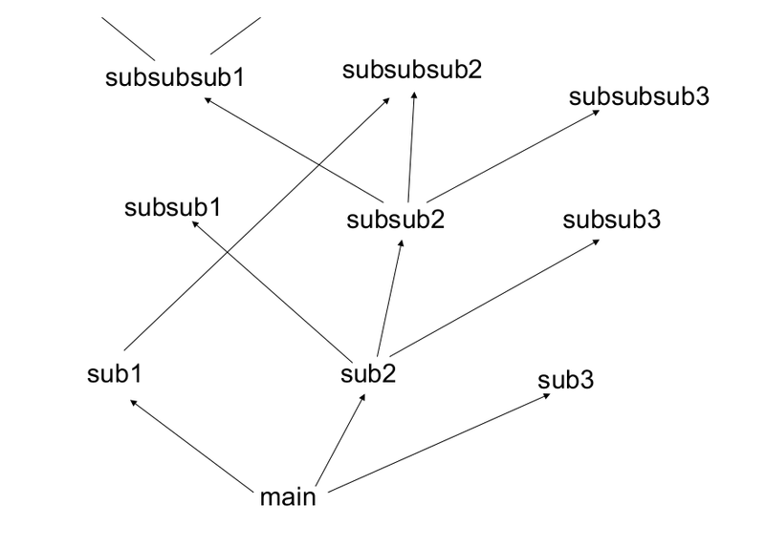
Analogy ─ Programming
Don’t put everything in your main function.
http://rinuboney.github.io/2015/10/18/theoretical-motivations-deep-learning.html

Slide 17
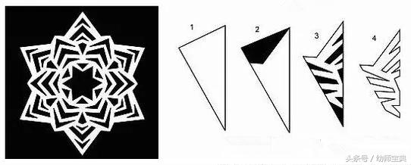
More Analogy
比較有效率
剪很多刀

Slide 18
以下三頁投影片上課時的數字有誤，已經將修改部的分套上紅色，感謝同學指出錯誤

Slide 19














$$x−0.5$$
$$1$$
+
$$−0.5$$
$$2$$
1
$$x$$
+
$$a_{1}$$
$$−x+0.5$$
$$2$$
+
$$−1$$
$$0.5$$
1
$$0$$
$$x$$
$$1$$
$$a_{1}$$

Slide 20


















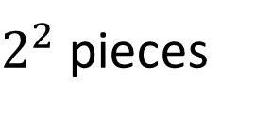
$$x−0.5$$
$$a_{1}$$
$$− 0.5$$
$$1$$
2
+
+
$$2$$
$$−0.5$$
1
$$−2$$
1
$$x$$
+
$$a_{2}$$
$$−x+0.5$$
$$2$$
$${−a}_{1}$$
$$+0.5$$
$$2$$
+
+
$$−1$$
$$−2$$
$$0.5$$
1
1
$$0$$
$$0$$
$$0$$
$2^{2}$ pieces
$$x$$
$$a_{1}$$
$$x$$
$$1$$
$$1$$
$$a_{1}$$
$$a_{2}$$
$$1$$
$$a_{2}$$

Slide 21



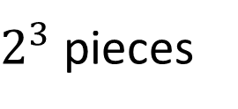


















$$x−0.5$$
$$a_{1}−0.5$$
$$a_{2}$$
$$− 0.5$$
$$1$$
$$2$$
+
+
+
$$2$$
$$−0.5$$
1
$$−2$$
1
1
$$x$$
$$a_{3}$$
$$−x+0.5$$
$$2$$
$${−a}_{1}+0.5$$
$${−a}_{2}+0.5$$
$$2$$
+
+
+
$$−1$$
$$−2$$
$$0.5$$
1
1
1
$$0$$
$$0$$
$$0$$
$2^{3}$ pieces
$$x$$
$$a_{2}$$
$$x$$
$$1$$
$$a_{2}$$
$$1$$
$$a_{3}$$
$$1$$
$$a_{3}$$

Slide 22








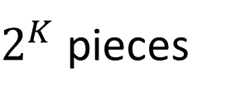
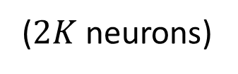
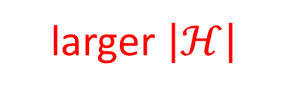

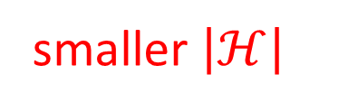

Deep
2 neurons
$2^{K}$ pieces
$$x$$
…..
$$y$$
$$0$$
$K$ layers
($2K$ neurons)
smaller $\left|ℋ\right|$
$$x$$
Shallow
$2^{K}$ neurons
larger $\left|ℋ\right|$
$$1$$
$$y$$
$$x$$
$$y$$

Slide 23


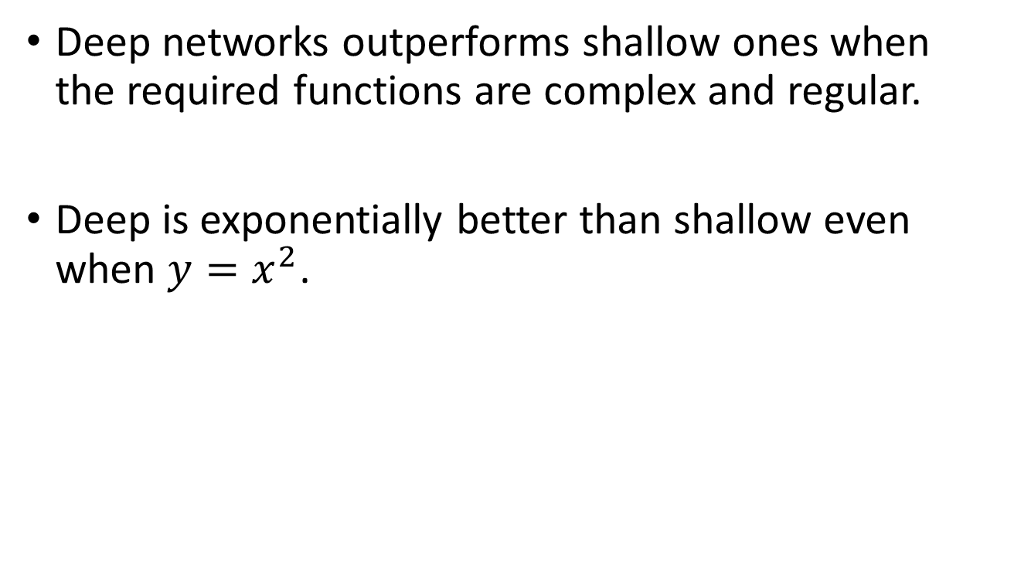
Thinks more ……
Deep networks outperforms shallow ones when the required functions are complex and regular.
Deep is exponentially better than shallow even when $y=x^{2}$.
Image, speech, etc. have this characteristics.
https://youtu.be/FN8jclCrqY0
https://youtu.be/qpuLxXrHQB4

Slide 24

深度學習是一個讓 魚與熊掌可以兼得的方法
Still small loss
$$h^{all}=arg\min_{h∈ℋ}{L\left(h,𝒟_{all}\right)}$$
Small (fewer candidates)

